Slide 1
Accessing the Curriculum for Diverse Learners
Fading Prompts

Slide 2
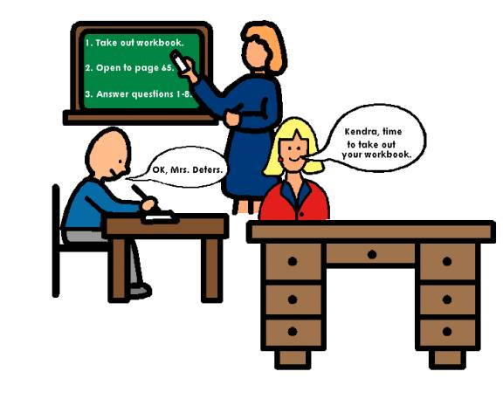
Find the mistake

Slide 3
The Lesson to be Learned
The student will NEVER be independent if s/he cannot learn to “see, read or hear” and respond to the natural cues.
If we continue to introduce unnatural cues or indicators, the student will never be able to respond to the natural indicator.
It is crucial students are taught to respond to the natural cues/indicators.

Slide 4
Cues
Something a teacher does or says to start instruction
Its purpose is to elicit a specific skill or behaviour from a student
Two basic types
Verbal (directions or questions)
Non-verbal (gestures, environmental, activity based)

Slide 5
Verbal Cues
Directions
Count the crayons
Questions
What colour is this?
Stand up please
Choose a learning center
Wash your hands
Give Jade the books
What could you say?
What letter does your name start with?
What comes next?

Slide 6
Non-verbal cues: what are these signaling to the student?
Passing a student a bowl of popcorn?
Patting the seat of an empty chair?
Flicking the light switch 2 times?
Providing only some of the supplies for a task?
Lifting your hands to gesture, “I don’t understand”.

Slide 7
Principles of Effective Instructional Cues
Given after the student’s attention is gained
Given once
To support the student learning to respond when a direction given, not after hearing a direction several times
Remember to provide time (wait time) to respond (rather than repeating the direction again and again)
The student needs think time to formulate what to say or to begin to take the appropriate action.

Slide 8
Principles of Effective Instructional Cues
Are clear and specifically stated, particularly when a student is first learning
Elicits a students response
Needs to involve some type of question, direction or action that requires a response from the student
Concise and not too many instructions at one time
Start with only a few directions at one time (depending on the learner as it can be difficult to work through several or long instructions to find the appropriate response

Slide 9

Principles of Effective Instructional Cues
Stay around to see that the student has completed the request – then move away, if appropriate, or continue to support the student in the least intrusive way

Slide 10
When do you prompt?
Instruction
Response
Reinforcement
Correction
Prompt

Slide 11
Types of Prompts
Natural Cue
Modeling
Physical
Gesture
Verbal
Visual

Slide 12
Fading Prompts
Delivered after or with the presentation (item or direction)
Most to least prompts
System of least prompts
Graduated Guidance
Time Delay

Slide 13
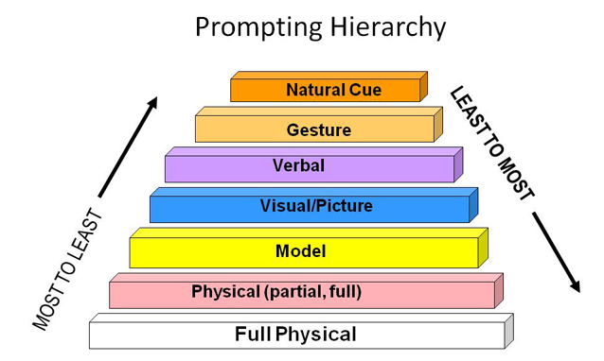
Prompting Hierarchy

Slide 14
Most-to-least prompts
Starts with physical support, so considered the most intrusive
Move, systematically, from the most up the hierarchy as student acquires the skill
Fade across trials
Need to consider students responses to touch (sometimes simply asking or letting a student know you are going to physically guide them can make a difference to any resistance)
May limit errors – so often used when a student is first learning an activity (though must remember the abilities of the learner as this can be too much support for some students)

Slide 15
Least-to-most prompts
Provides student with an opportunity to perform the response with the least amount of assistance
The student always has an opportunity to respond and the instructor is guided by the student’s behaviour in terms of determining the degree of assistance necessary
May lead to more errors
Used once a skill is learned

Slide 16
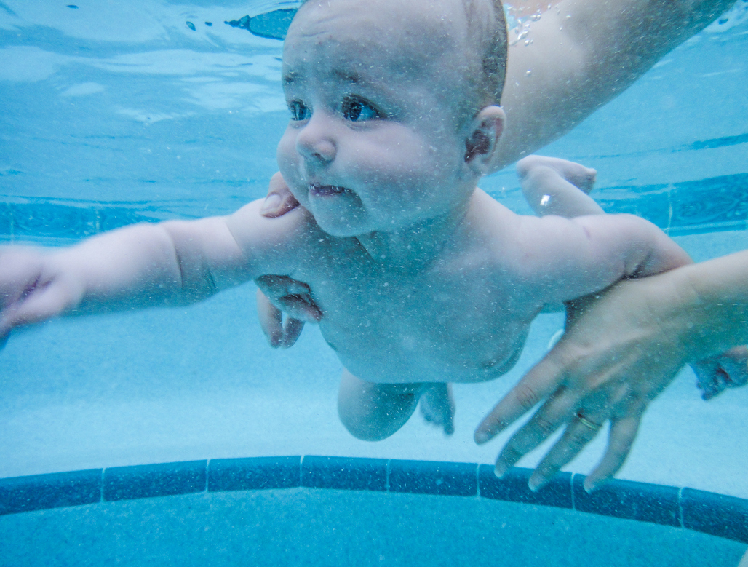
Graduated Guidance
Shadowing:
The instructor follows the student’s movements with their hands very near, but not touching the student.
Systematically increase the distance of hands from the student

Slide 17

Time Delay (aka Wait Time)
Insert a delay between giving an instruction and stepping in and prompting
Minimizes errors while learning a new skill
Sometimes the most effective (and hardest) thing to do is WAIT
Always give wait time!

Slide 18

Wait Time / Time Delay
Following a direction or question, WAIT for the student to
Process what you said
Formulate his/her response
Instead of prompting a student to initiate a task, WAIT
Increase length of pause over time to promote independence

Slide 19
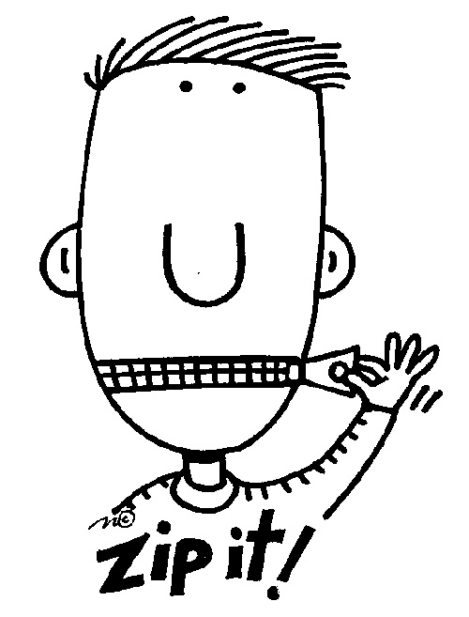
Time Delay / Wait Time
Usually 3-5 seconds, but may need to be longer or shorter depending on the student
Pair with a “expectant look” (not a verbal prompt if possible, as a verbal prompt is harder to fade)

Slide 20

10 Ways to Prompt without talking
Touch the student lightly
Model it
Point to / tap book or paper
Use a high lighter
Draw a picture (small dry eraser boards work well)

Slide 21

10 Ways to Prompt without talking
Move closer
Write on a post it note
Use a pen-light
Use gesture / sign (thumbs up, expectant look, shrugging of shoulders)
Have peer give assistance

Slide 22
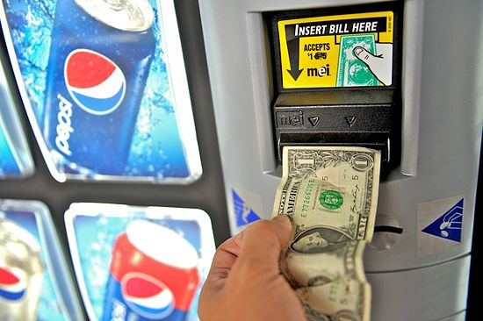
Activity: Using a vending machine
Watch video
Record the prompts
Discuss what is working / not working
What skills does this student have?
Create a discrepancy analysis
What instructional strategies, adaptations and prompts would you use next time?

Slide 23

Review – what do you need to practice?

